Slide 1

Ethereum
Fraud Detection
Arjun Chanda| Jai Agrawal | Ambika Mudigonda | Qiuhan Li | Sahithi Muddana

Slide 2
Contents
Introduction to Ethereum
Ethereum Transactions
Fraud in cryptocurrency
Exploratory Data Analysis
Model Results
Findings

Slide 3
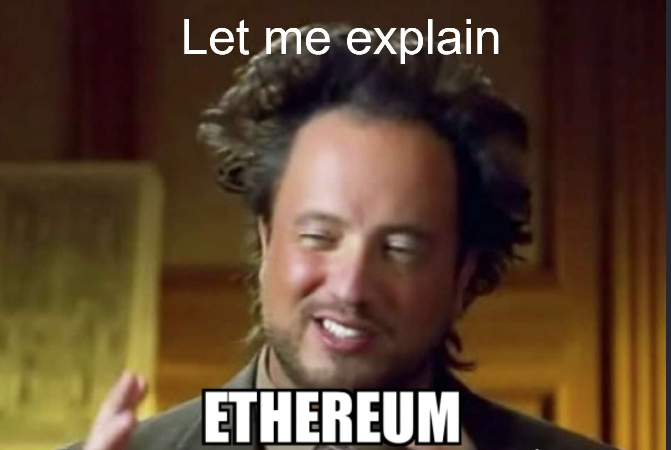
Introduction to Ethereum
Founded by Vitalik Buterin (Co-Founder of Bitcoin Magazine)
Proposed in late 2013 and released in 2014
It is a platform, NOT a currency
The currency is called Ether
Market Cap: $311 Billion
Notes:
DIY platform for Decentralised Apps (DApps)
Infrastructure for running DApps worldwide

Slide 4
Ethereum Transactions
Bus → Block
People → Transactions
Ethereum capacity → 500 txn per block

Slide 5
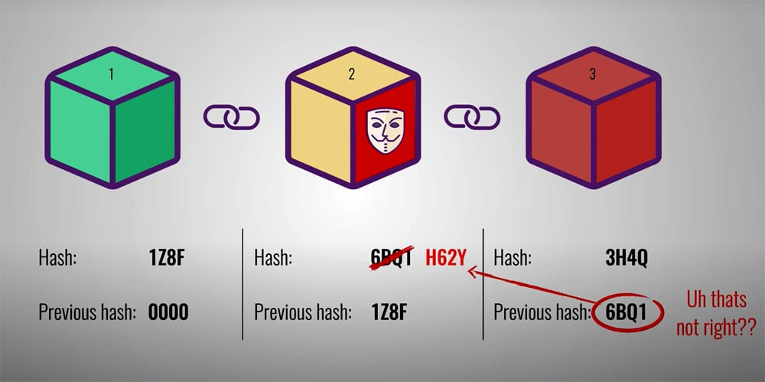
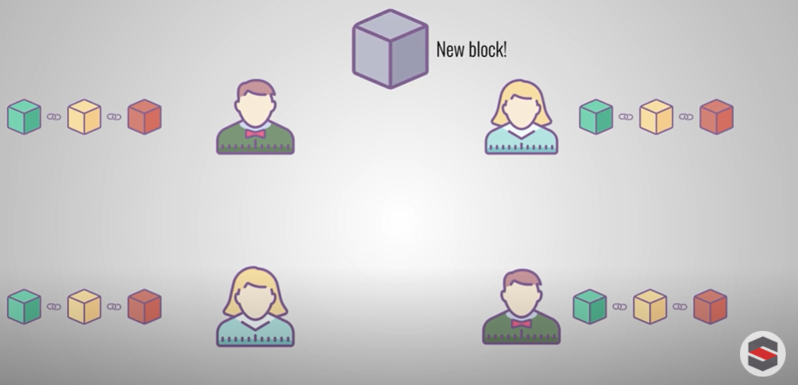
Fraud in Cryptocurrencies
1
Miners using Transaction fee (Gas in Gwei)
2
Contracts using Honeypots
Notes:
Developer - (code in Solidity) compiler - convert to white code
Ether is dollar, Gwei is cents

Slide 6
Data (Ether and Smart contracts)
51
9841
variables
(EtherScan)
records
Transactions
Variables : 34
Valid : 7,662 records (85%)
Fraudulent : 1,350 records (15%)
Training : 1350 Rows
Test : 1350 Rows
Distribution of 0’s and 1’s is 50%

Slide 7
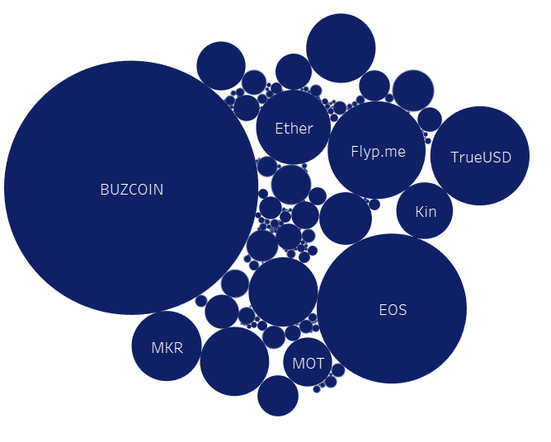
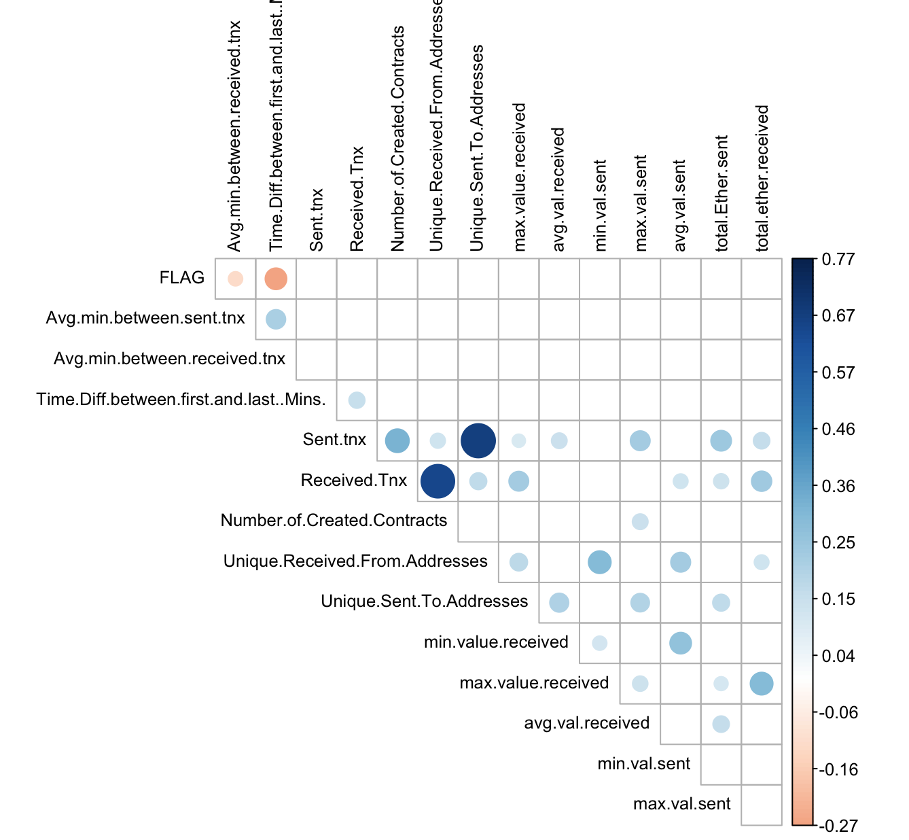
Exploration
Most used Token
Correlation Matrix

Slide 8
Model Results
 | Logistic Regression | Naive Bayes | KNN | Decision Tree | Random Forest
Accuracy | 83.19% | 56.74% | 84.15% | 92.74% | 96.22%
Precision | 87.71% | 82.27% | 86.07% | 95.29% | 96.02%
Recall | 77.19% | 17.19% | 81.48% | 89.93% | 96.44%

Slide 9
FINDINGS
KEY VARIABLES
INSIGHTS
Time between Transactions
Value of Ether received
Total number of token transactions
Shorter time difference between transactions
Lower value Ether transactions
Less transactions
⇒ HIGHER CHANCE OF FRAUD

Slide 10

THANK YOU

